Slide 1
Web Form Fundamentals
Notes:
MIS 324 -- Professor Sandvig

Slide 2

Outline
Web Forms
  Three sections
Order of Execution
Viewstate
Notes:
MIS 324 -- Professor Sandvig

Slide 3
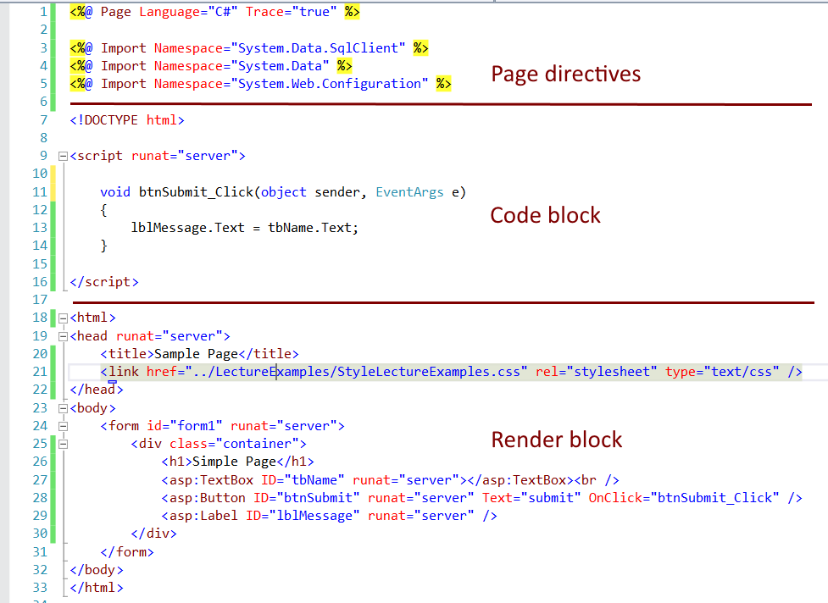
Web Forms
Notes:
MIS 324 -- Professor Sandvig

Slide 4

1. Page Directives
Set page properties
  Language, debugging, tracing, …
Import additional class libraries
  Common ones imported automatically
  Additional:
    Database access, data manipulation, web services, drawing, communication…
Notes:
MIS 324 -- Professor Sandvig

Slide 5
2. Code Declaration Blocks
Syntax:
    <script runat=“server”>
      //Server-side code here…
    </script>
Locate:
  Anywhere on page → usually at top
  Another file → Code-Behind
Notes:
MIS 324 -- Professor Sandvig

Slide 6
3. Code Render Block
Contain:
  HTML
  Text
  Server Controls
Typically located below Code block
  Location does not affect output
Notes:
MIS 324 -- Professor Sandvig

Slide 7
Outline
Web Forms
  Three sections
Order of Execution
Viewstate
Notes:
MIS 324 -- Professor Sandvig

Slide 8
Order of Execution
.NET is event driven
  Events include:
    Page load
    Button click
    checkbox checked
    textbox text changed
    etc.
We write handlers (methods) to handle events
Events fired in sequence
Page Life Cycle overview (for the curious)
Examples:
  PostBack.aspx handout
Notes:
MIS 324 -- Professor Sandvig

Slide 9
Outline
Web Forms
  Three sections
Order of Execution
Viewstate
Notes:
MIS 324 -- Professor Sandvig

Slide 10
ViewState
Saves control data
  Encoded in hidden form field
Benefit: convenience
Disadvantage
  Processing overhead
  Bandwidth
  NovusHR
Turn off with:
  EnableViewState=“false”
    Individual controls
    Page (in page directive)
Notes:
MIS 324 -- Professor Sandvig

Slide 11
Web Form Summary
Designed to separate code and presentation
Event driven
  User events
  Page events
Granular control of event handling
Viewstate provides convenience
Notes:
MIS 324 -- Professor Sandvig

